Slide 1
Waihora Ellesmere Trust
Annual Report 2017/18

Slide 2
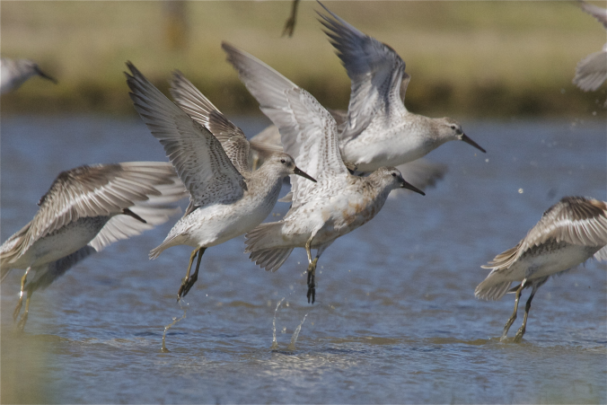
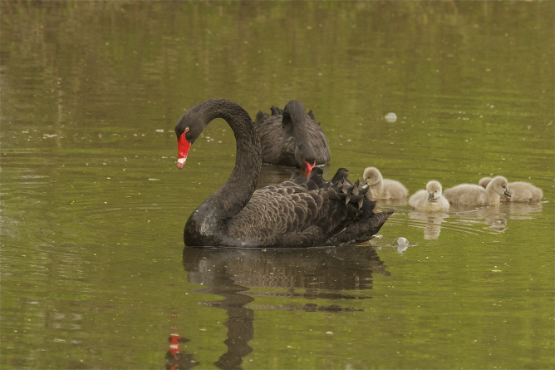
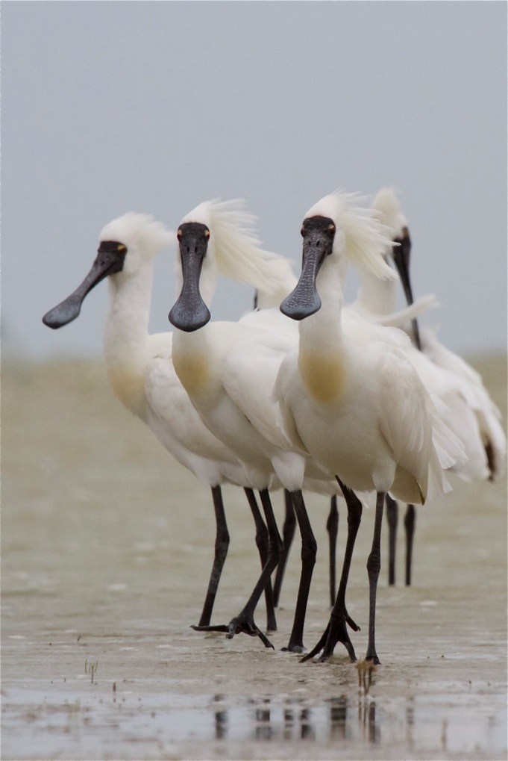
The Trust
Membership of around 65 individual/family members plus 4 organisations
371 subscribers to the newsletter/ 474 Facebook followers
2 staff members - General Manager and Finance Manager
MOUs with ECan, DOC, CCC, SDC and TAK
Funding & support from SDC, Ecan
Regular updates to website and social media (Facebook, twitter)
Regular newsletters

Slide 3
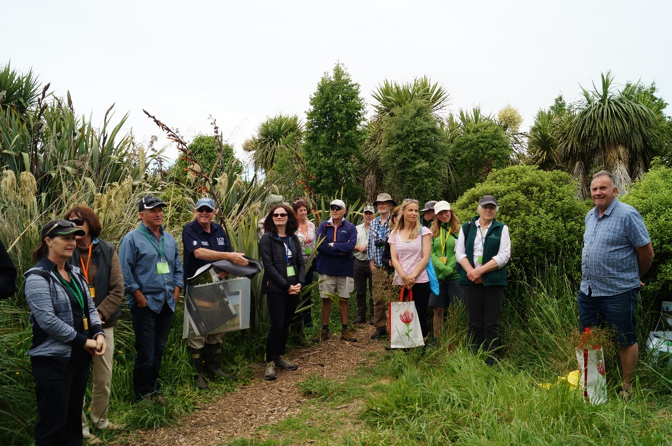
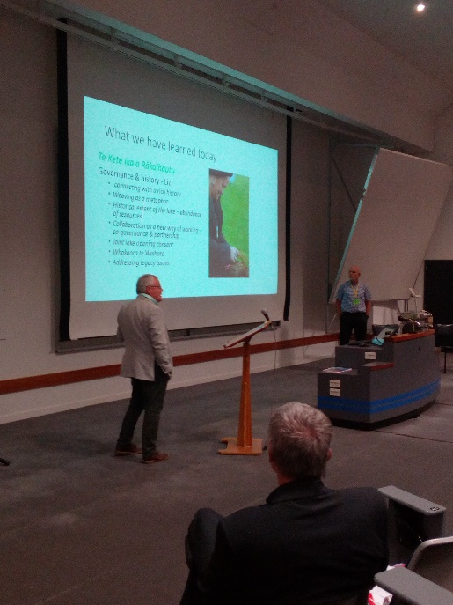
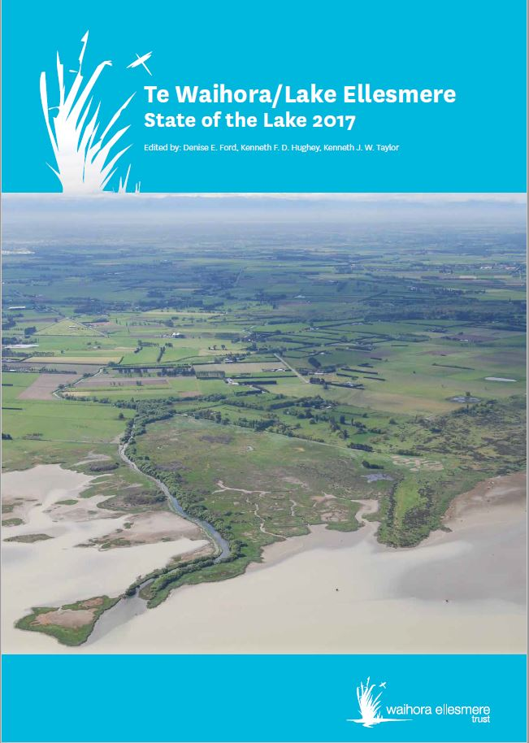
2018 Living Lake Symposium and the State of the Lake Report
November 2018

Slide 4
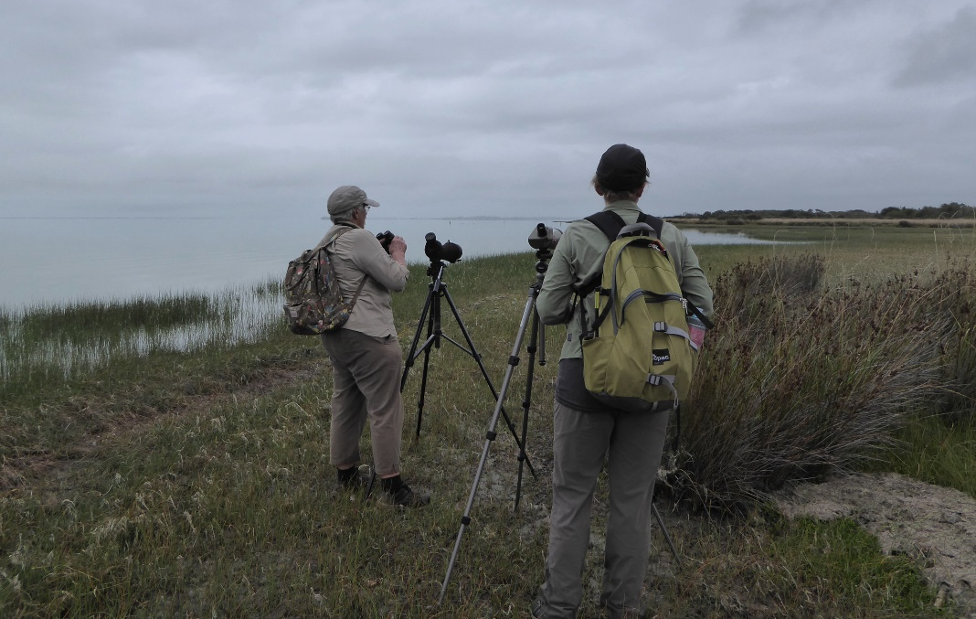
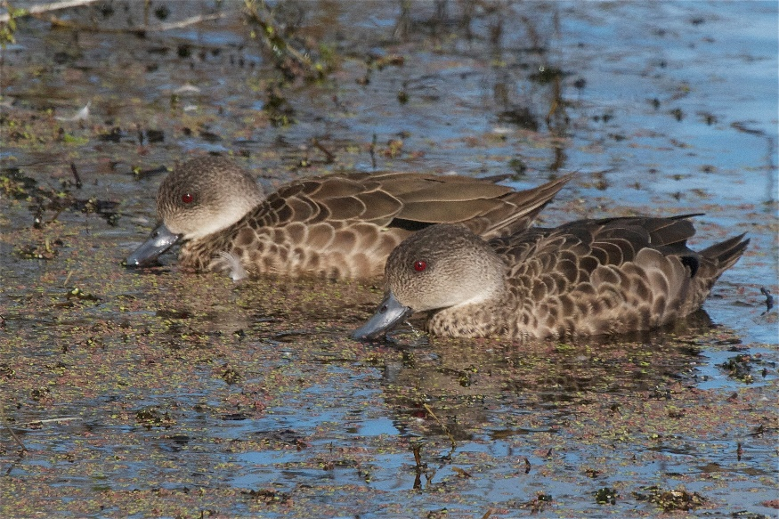
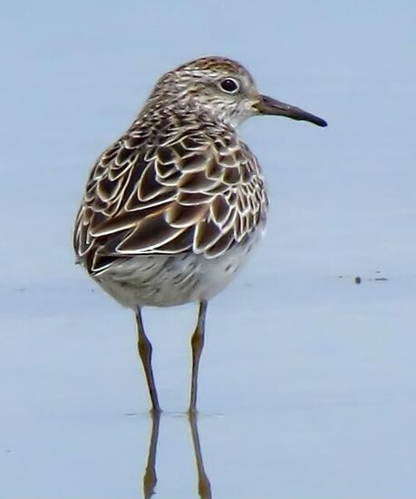
2018 Te Waihora wetland bird survey –with partners, Birds NZ, CCC and DOC, to organise a census of wetland birds on the lake.
•51,807 in 2018
•42,852 in 2017
•41,590 in 2016
•47,858 in 2015
•55,164 in 2014
•55,728 in 2013
Grey Teal – most common bird 17,773

Slide 5
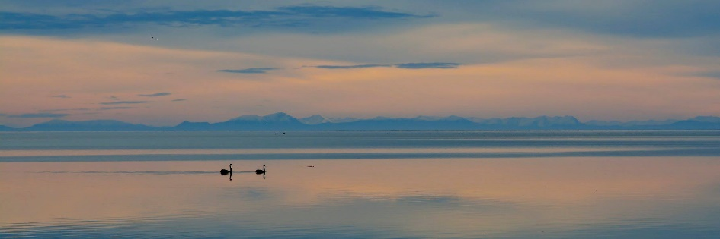
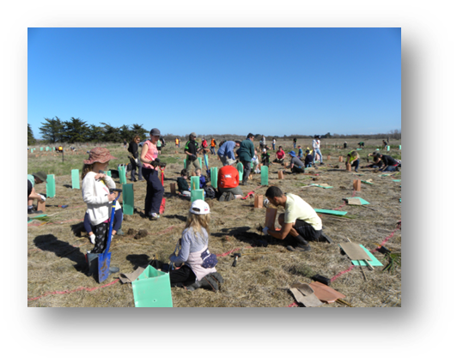
Talking to Groups/Attending Events
Schools, Waterwise, ECO Canterbury and others
Presenting to the Wetland Conference in Napier next week
Ellesmere Show
Little River Photo Competition
Weed Liaison Group
Facilitating SWARF group
Submitted to Long-Term Plans for ECAN,
SDC and CCC
Restoration Activities
YHA Greenfoot print Planting – happening this Friday
Assisting Te Ara Kākāriki (TAK) with Community Plantout and Kids Discovery Day
Facilitate SWARF meetings
Member of the Tarerekautuku Yarrs Lagoon Care Group.
Member of the Selwyn River / Waikirikiri working group

Slide 6
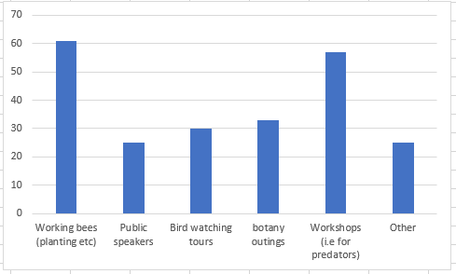
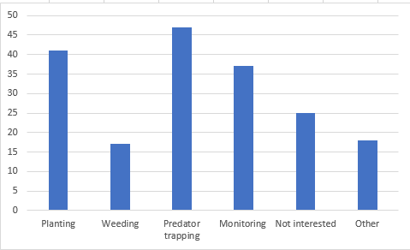
Survey (120 respondents)
What activities would you like to see the Waihora Ellesmere Trust run?
Would you be interested in being involved in hands on tasks around Te Waihora / Lake Ellesmere

Slide 7
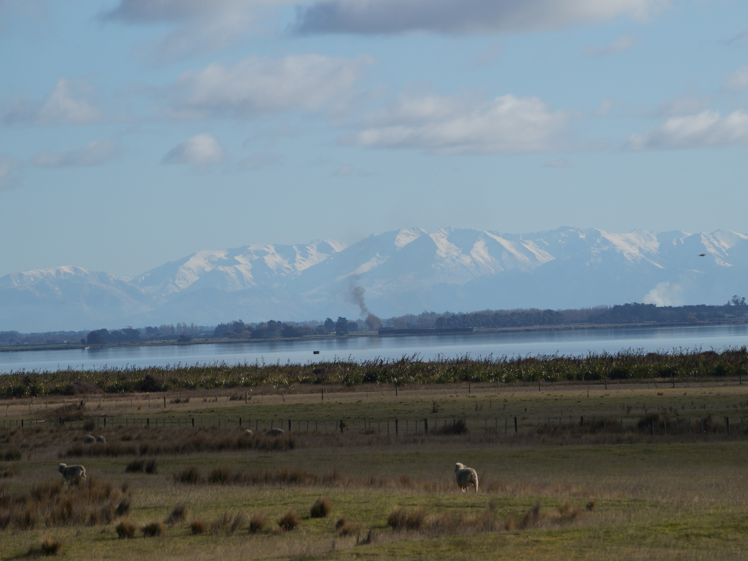
What’s coming up for 2018/19
Planning for the 2019 Living Lake Symposium and State of the Lake Report
Two Lakes Healing cycle tour (Oct 5th)
Field trips for members and supporters
Investigating community trapping programmes (Predator Free 2050) namely at Yarrs Flat
Working to promote recreational opportunities at the lake, including with DOC, local schools and others to provide interpretation at Harts Creek
2019 bird survey (Feb 2019)
Promoting our Living Lake Research & Monitoring Fund
And lots more…….

